Slide 1
Basic Skills Activities - Overview
I set you challenges on the days you are at home.
Day 1
Day 2
Day 3
Day 4
Butterfly Day
Handwriting
Speaking – Would you rather…?
Length game
Handwriting
Maths – add and subtract
I set a challenge on the day you are in school (Butterfly Day) or for an extra home learning day.
Notes
for
parents
Butterfly Day is the children’s allocated day in school (for those children who are returning). Days 1-4 can be used in any order, to support home learning on the other days. For children who are at home all week, Butterfly Day can be used alongside Days 1-4, in any order.

Slide 2
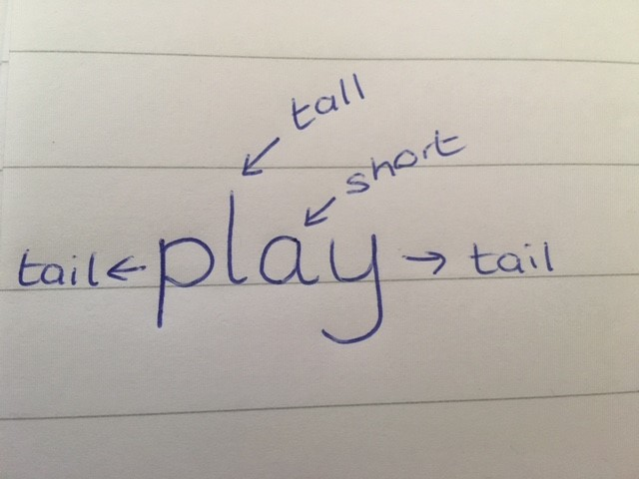
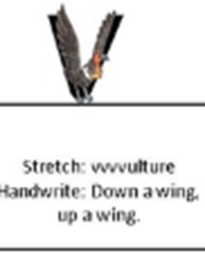
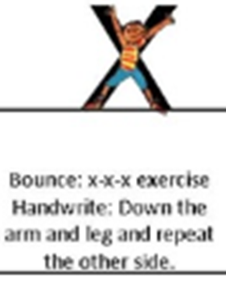
Day 1: Handwriting
On lined paper, practise these ‘robot letters’ which all start at the top. Look at how they are placed on a line.
Short letter
Short letter
Short letter
Notes
for
parents
Notes
for
parents
These letters are all ‘robot’ letters which all start at the top and sit on the line. The children need to be careful with the size of the letters and make sure they have sharp corners not curved ones.
Resources needed
Lined paper
Pencil

Slide 3
Day 2: Speaking - Would you rather…?
Would you rather have chips or chocolate? Remember to answer in a full sentence and give a reason for your answer. For example… I would rather have ____________ because….
or
Notes
for
parents
Notes
for
parents
Resources needed
None
Encourage the children to ask the question with you and to speak in full sentences for this and their answer.
We have done this activity many times in school so they should be familiar with it.

Slide 4
Day 3: Number game
Play I’m thinking of a number. Choose one of the numbers and describe it to someone. For example… “I’m thinking of a number. It is larger than 4 but smaller then 6 or it is between 4 and 6. It is 1 more than 4 but 1 less than 6.
Notes
for
parents
Notes
for
parents
This game focuses on the place value and recognition of a number using linked mathematical vocabulary to describe them, e.g. more, less, between.
Try swapping roles so that they get a chance to answer as well as describe.
Resources needed
None

Slide 5
Day 4: Handwriting
On lined paper, practise these ‘robot letters’ which all start at the top. Look at how they are placed on a line.
Short letter
Short letter
Short letter
Notes
for
parents
Notes
for
parents
These letters are all ‘robot’ letters, they all start at the top and sit on the line. The children need to be careful with the size of the letters and make sure they have sharp corners not curved ones.
Resources needed
Lined paper
Pencil

Slide 6
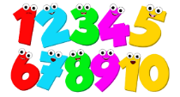
Butterfly Day: Maths – addition and subtraction
Can you solve these problems? Remember to look carefully to see if you need to add or subtract (take-away). Try the problems in black first and then the problems in green if you need a challenge.
8 – 5 =
7 + 2 =
5 + 5 =
6 - 2 =
14 – 5 =
15 + 5 =
16 – 5 =
12 + 7 =
Notes
for
parents
The children may use a range or methods / resources to work them out, e.g.
- using fingers or other physical resources
- using jottings (drawings)
- using known number facts, e.g. If they know 5 add 5 is 10, this may help with 15 + 5
- by counting on from the biggest number (for addition)
Notes
for
parents

