Slide 1
Daily Reading and Writing - Overview
Reading
Story time – book of the week
Read and match
Tricky (red) words.
True or false?
Silly questions
Writing
Daily sentence writing from picture
What is your favourite toy or game?
Daily sentence writing from picture
Daily sentence writing from picture
Superhero writing
Day 1
Day 2
Day 3
Day 4
Butterfly Day
I set a challenge on the day you are in school (Butterfly Day) or for an extra home learning day.
Notes
for
parents
Butterfly Day is the children’s allocated day in school (for those children who are returning). Days 1-4 can be used in any order, to support home learning on the other days. For children who are at home all week, Butterfly Day can be used alongside Days 1-4, in any order.

Slide 2
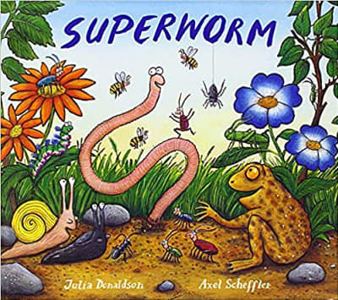
Day 1 – Reading
Read Superworm. If you don’t have a copy of the story at home you can use one of the links below.
https://stcharlescatholicprimary.com/brightenupday/superworm-by-julia-donaldson-childrens-bedtime-stories/

Slide 3
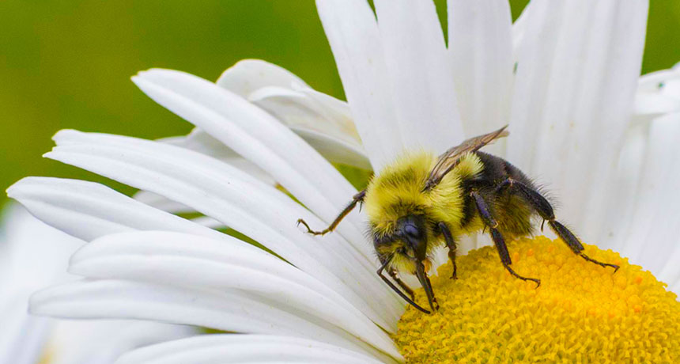
Day 1 – Writing
. ?
Can you write some words from the picture?
_________________________________________
_________________________________________
_________________________________________
Can you write a sentence?
_________________________________________________________________________________________________
_________________________________________________________________________________________________

Slide 4
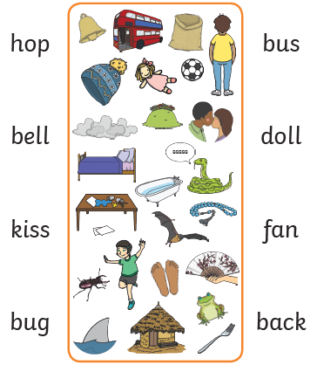
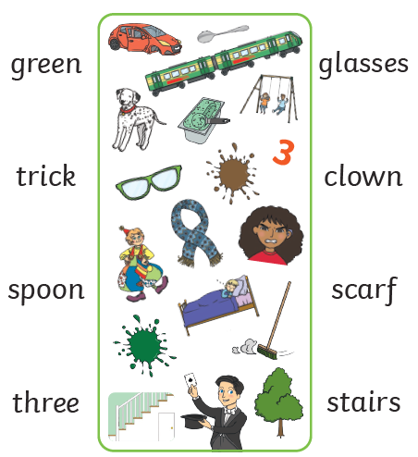
Day 2 – Reading
Can you read these words and find the matching picture?

Slide 5
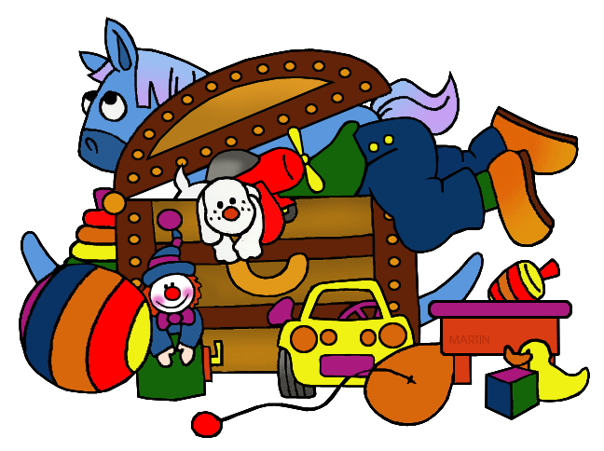
Day 2 – Writing
. ?
Can you list some of your favourite toys or games?
_________________________________________
_________________________________________
_________________________________________
What is your favourite toy or game?
Can you write a sentence about one of them?
_________________________________________________________________________________________________
_________________________________________________________________________________________________

Slide 6
Day 3 – Reading
Keep practising these tricky words.Try the first group, and then move onto the other ones if you need more challenge. You can read them on here, or make up a game. For example, write the words on paper and then place them around the room. Follow an instruction, such as… hop to she … jump to they.
I
my
go
the
to
we
he
she
they
was
said
of
all
going
are
you
Notes
for
parents
At school, we call tricky words ‘Red Words’. They are tricky because they cannot be sounded out using phonics, so we need to remember them by sight. This will help to increase the children’s sight vocabulary and the speed with which they read (fluency).

Slide 7
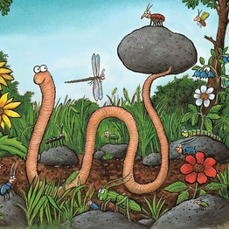
Day 3 – Writing
. ?
Can you write some words from the picture?
_________________________________________
_________________________________________
_________________________________________
Can you write a sentence?
_________________________________________________________________________________________________
_________________________________________________________________________________________________

Slide 8
Day 4 – Reading
With help from an adult or older brother / sister, read these sentences about ‘Superworm’ then decide if they are true or false? Thumbs up for ‘True’ and thumbs down for false.
Superworm is super long.
Superworm has got lots of friends.
The lizard is very kind to Superworm.
A big black crow picks up Superworm with his claws.
true
false
Notes
for
parents
If the children are able to use their phonics to read some words, that’s great. However, because the purpose of this activity is to focus on their understanding of the story (comprehension), it is fine if someone reads the sentences to them.

Slide 9
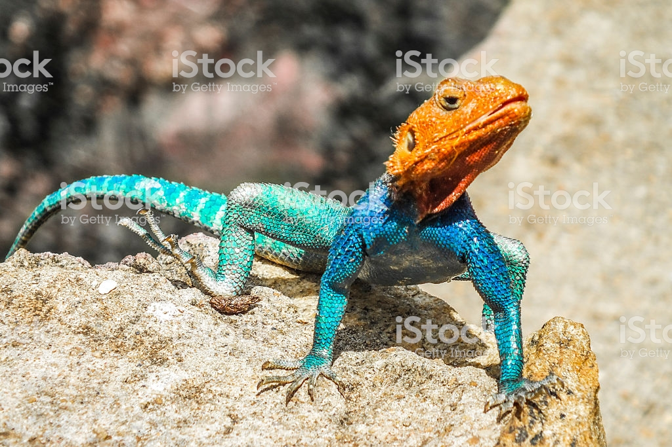
Day 4 – Writing
. ?
Can you write some words from the picture?
_________________________________________
_________________________________________
_________________________________________
Can you write a sentence?
_________________________________________________________________________________________________
_________________________________________________________________________________________________

Slide 10
Butterfly Day – Reading
Can you read these silly questions, using your phonics? They are so silly, because the answer is very obviously Yes or No. Remember to look at each word to see if you know it straight away. If not, look for special friends and then sound out and blend each word. Black questions focus on Set 1 sounds. The ones in green focus on Set 2, with the odd Set 3 sound.
Can a fish swim ?
Has a fox got six legs?
Can a chip run?
Will you see a book reading itself?
Is it dark at night?
Is the queen three years old?
By answering Yes or No, the children demonstrate if they have understood the question (comprehension).
For longer words, e.g. ‘reading’, we ‘chop it up’, so that they sound out and blend the first part of the word and then the rest. Some children may recognise the word ending (suffix) ‘ing’ straight away, without sounding it out.
yes
no
Notes
for
parents

Slide 11
Butterfly Day – Writing
. ?
If you could be a superhero for a day, what would your special power be? What would you use it for?
Remember to write in full sentences, using finger spaces between each word.
Notes
for
parents
The children will probably spell things the way they sound, using the sounds they know. For example, if they choose to write ‘fly’ they may spell it ‘fligh’.

