Slide 1
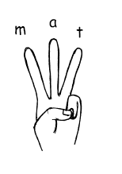
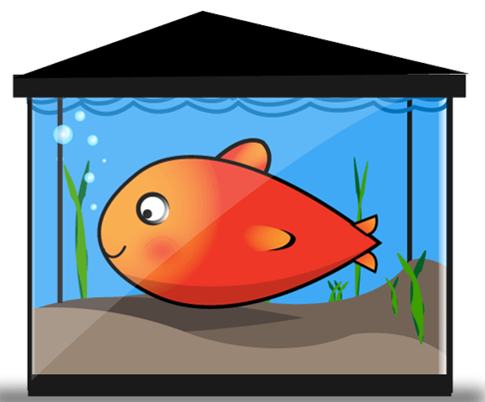
Monday 20th April
Can you write some words from the picture?
_________________________________________
_________________________________________
_________________________________________
Can you write a sentence?
_________________________________________________________________________________________________
_________________________________________________________________________________________________

Slide 2
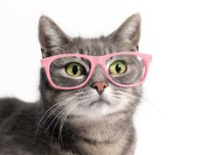
Tuesday 21st April
Can you write some words from the picture?
_________________________________________
_________________________________________
_________________________________________
Can you write a sentence?
_________________________________________________________________________________________________
_________________________________________________________________________________________________

Slide 3
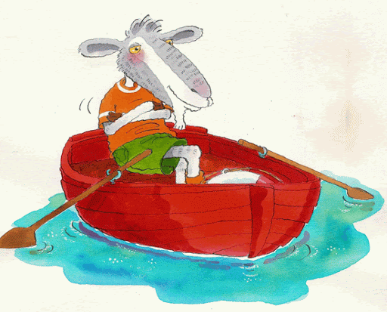
Wednesday 22nd April
Can you write some words from the picture?
_________________________________________
_________________________________________
_________________________________________
Can you write a sentence?
_________________________________________________________________________________________________
_________________________________________________________________________________________________

Slide 4
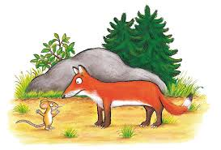
Thursday 23rd April
Can you write some words from the picture?
_________________________________________
_________________________________________
_________________________________________
Can you write a sentence?
_________________________________________________________________________________________________
_________________________________________________________________________________________________

Slide 5
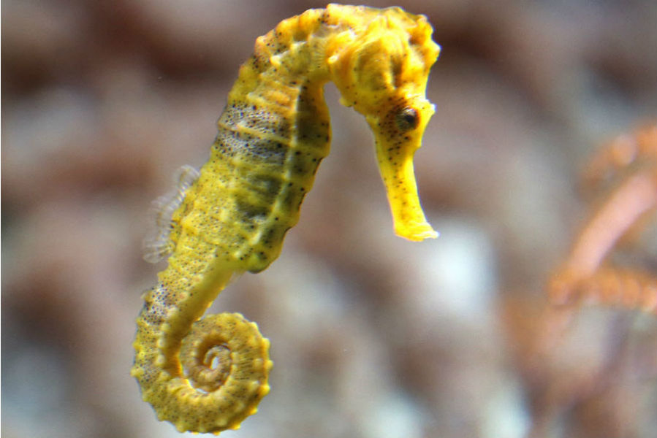
Friday 24th April
Can you write some words from the picture?
_________________________________________
_________________________________________
_________________________________________
Can you write a sentence?
_________________________________________________________________________________________________
_________________________________________________________________________________________________

