Slide 1
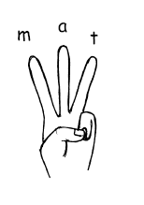
Monday 1st June
Can you write some words from the picture?
_________________________________________
_________________________________________
_________________________________________
Can you write a sentence?
_________________________________________________________________________________________________
_________________________________________________________________________________________________

Slide 2
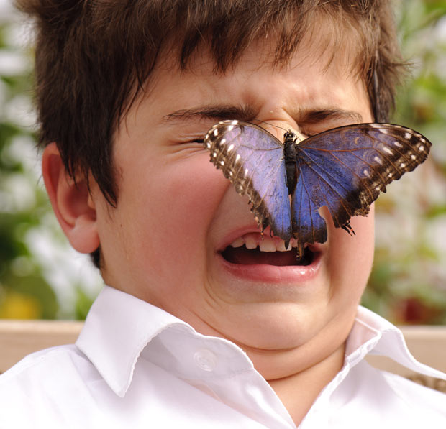
Tuesday 2nd June
Can you write some words from the picture?
_________________________________________
_________________________________________
_________________________________________
Can you write a sentence?
_________________________________________________________________________________________________
_________________________________________________________________________________________________

Slide 3
Wednesday 3rd June
Can you write some words from the picture?
_________________________________________
_________________________________________
_________________________________________
Can you write a sentence?
_________________________________________________________________________________________________
_________________________________________________________________________________________________

Slide 4
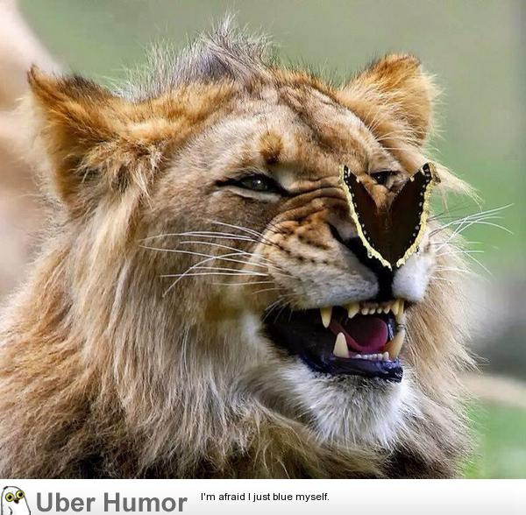
Thursday 4th June
Can you write some words from the picture?
_________________________________________
_________________________________________
_________________________________________
Can you write a sentence?
_________________________________________________________________________________________________
_________________________________________________________________________________________________

Slide 5
Friday 5th June
Using your life-cycle of a butterfly work (see Topic), can you label the parts of the life-cycle? Remember to use your phonics to sound out and spell words. For longer words, clap out the syllables and try each one at a time.
Challenge: Can you write a sentence to describe part of the life-cycle?

