Slide 1
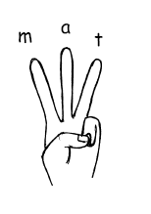
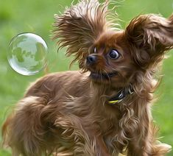
Monday 4th May
Can you write some words from the picture?
_________________________________________
_________________________________________
_________________________________________
Can you write a sentence?
_________________________________________________________________________________________________
_________________________________________________________________________________________________

Slide 2
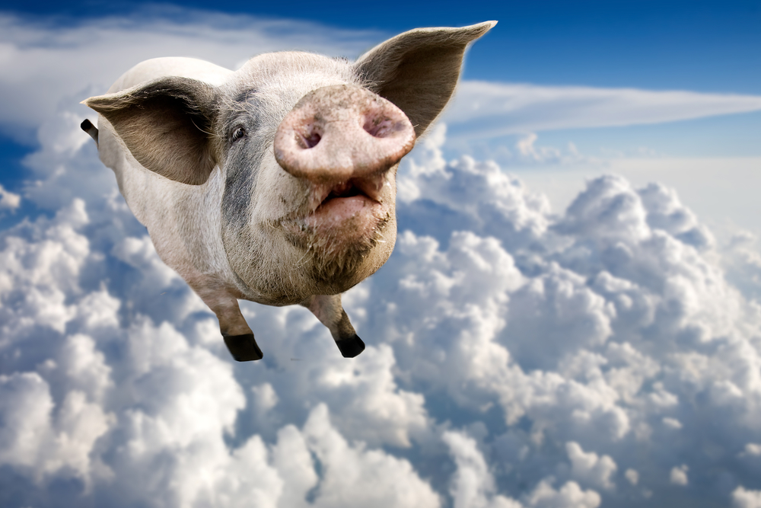
Tuesday 5th May
Can you write some words from the picture?
_________________________________________
_________________________________________
_________________________________________
Can you write a sentence?
_________________________________________________________________________________________________
_________________________________________________________________________________________________

Slide 3
Wednesday 6th May
Can you write some words from the picture?
_________________________________________
_________________________________________
_________________________________________
Can you write a sentence?
_________________________________________________________________________________________________
_________________________________________________________________________________________________

Slide 4
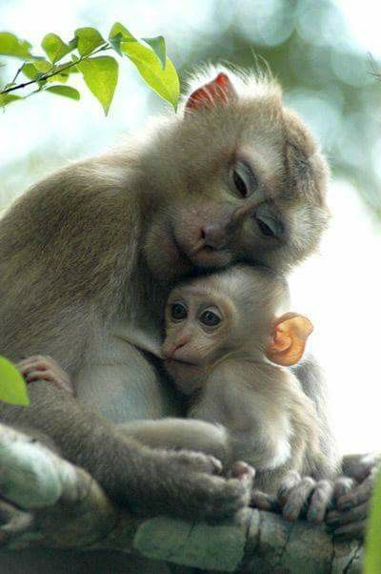
Thursday 7th May
Can you write some words from the picture?
_________________________________________
_________________________________________
_________________________________________
Can you write a sentence?
_________________________________________________________________________________________________
_________________________________________________________________________________________________

Slide 5
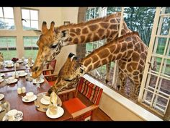
Friday 8th May
Can you write some words from the picture?
_________________________________________
_________________________________________
_________________________________________
Can you write a sentence?
_________________________________________________________________________________________________
_________________________________________________________________________________________________

