Slide 1
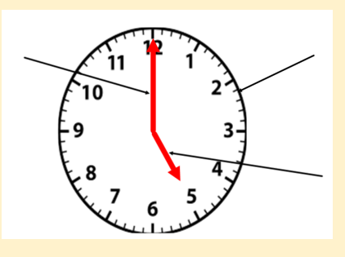
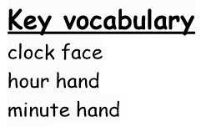
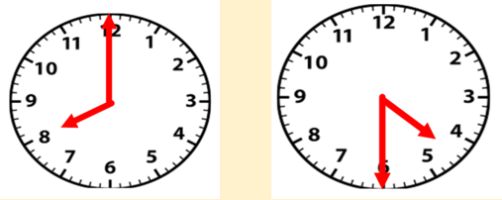
Quick quiz…
a.
b.

Slide 2
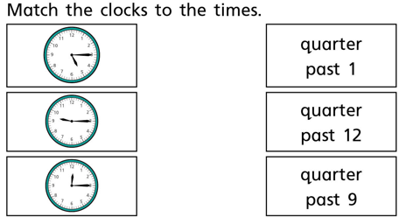
When the clock shows quarter past the minute hand is on the _______
What do you notice about the hour hand?

Slide 3
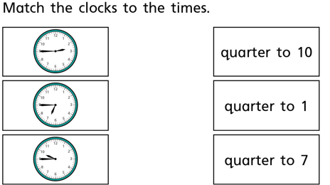
When the clock shows quarter to the minute hand is on the _______
What do you notice about the hour hand?

Slide 4
Reasoning problem:

