Slide 2
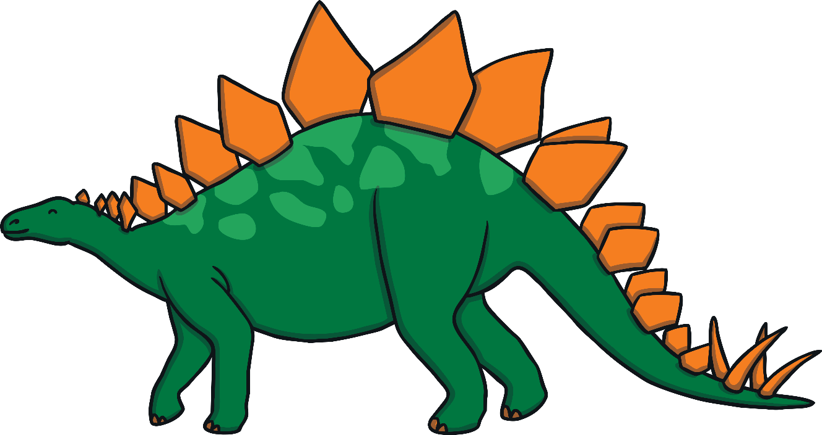
What Is a Dinosaur?
Dinosaurs were one of several kinds of prehistoric reptiles that lived during the Mesozoic Era, the “Age of Reptiles”. They lived millions of years ago, before people.

Slide 3
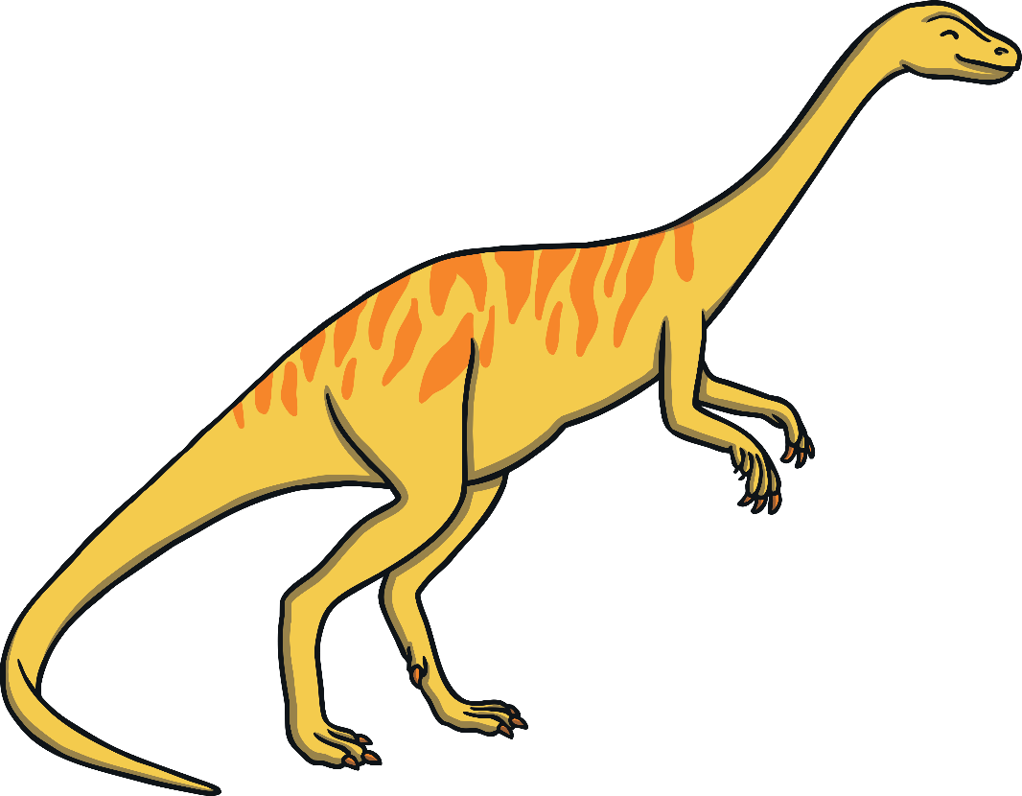
What Is a Dinosaur?
We can’t be sure how the dinosaurs sounded, how they behaved, how they mated or what colour and pattern they were.
?

Slide 4
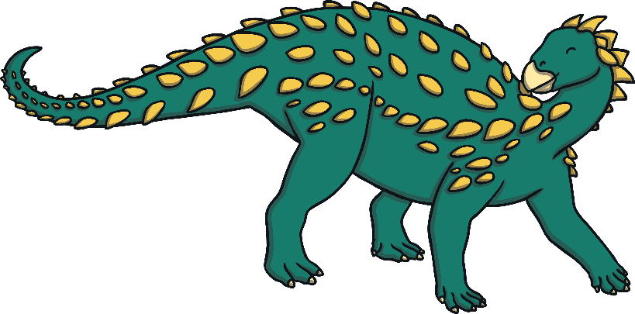
There were lots of different kinds of dinosaurs that lived at different times.
Some walked on two legs and some on four. Some could do both
Some were speedy and some were slow and lumbering.
Some had thick, bumpy skin. Some even had feathers.
Some were armour plated, some had horns, crests, spikes or frills to defend themselves.

Slide 5
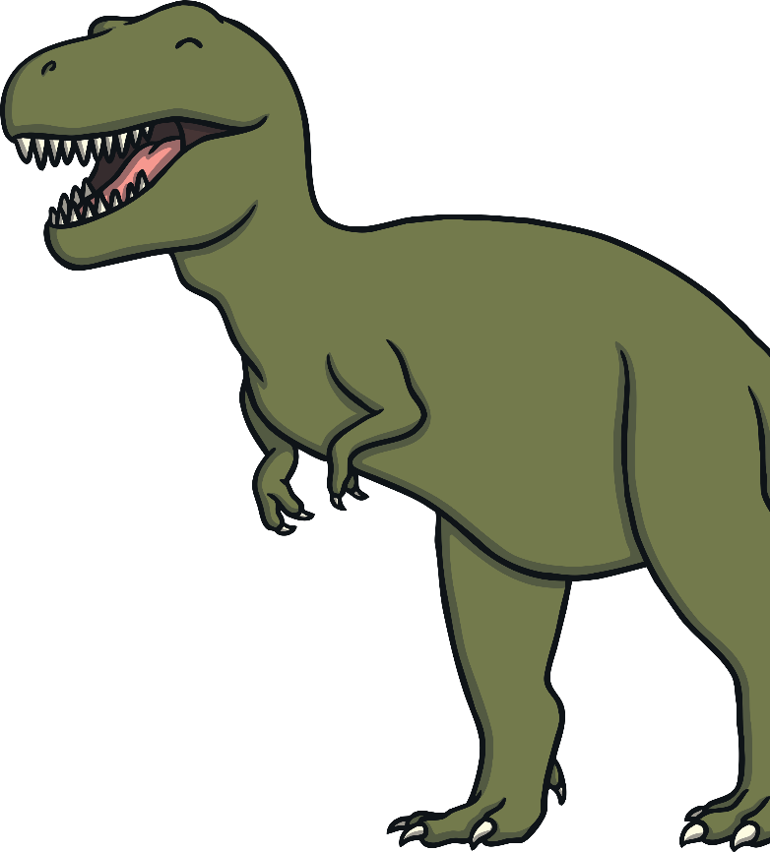
Most dinosaurs were plant-eaters. These are called herbivores.
Some dinosaurs were meat-eaters. These are called carnivores.

Slide 6
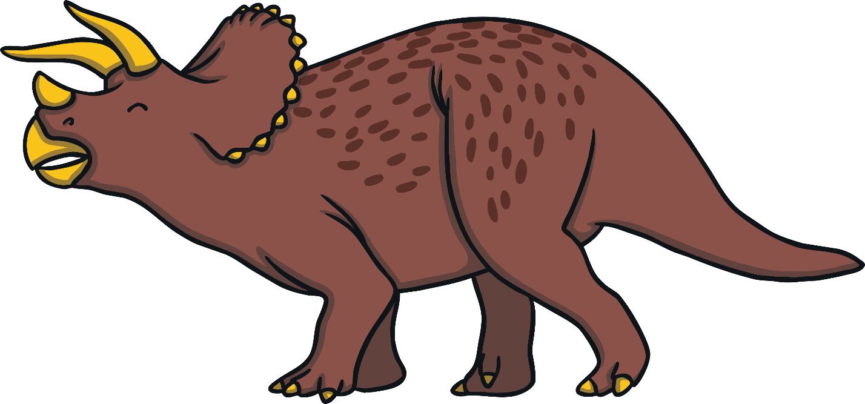
Most dinosaurs became extinct 65 million years ago, probably because of an asteroid that hit the earth. This would have made a big change to the climate, and the dinosaurs couldn’t adapt.

