Slide 1
Hedgehogs
Anna and oscar

Slide 2
Baby hedgehogs are called hoglets and they have no fur when they are a baby.

Slide 3
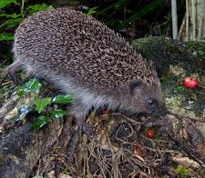
What do they eat?
Hedgehogs are omnivores which means they eat plants and meat.

Slide 4
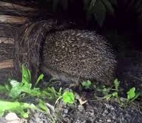
Where do they live?
Hedgehogs live in woodland and park.

Slide 5
Did you know
Did you know they live in the whole of the united kindon

